Slide 1
Paper review
A Whole-slide foundation model for digital pathology from real-world data
Credits: Ao Dong, John(chenxi) Song

Slide 2
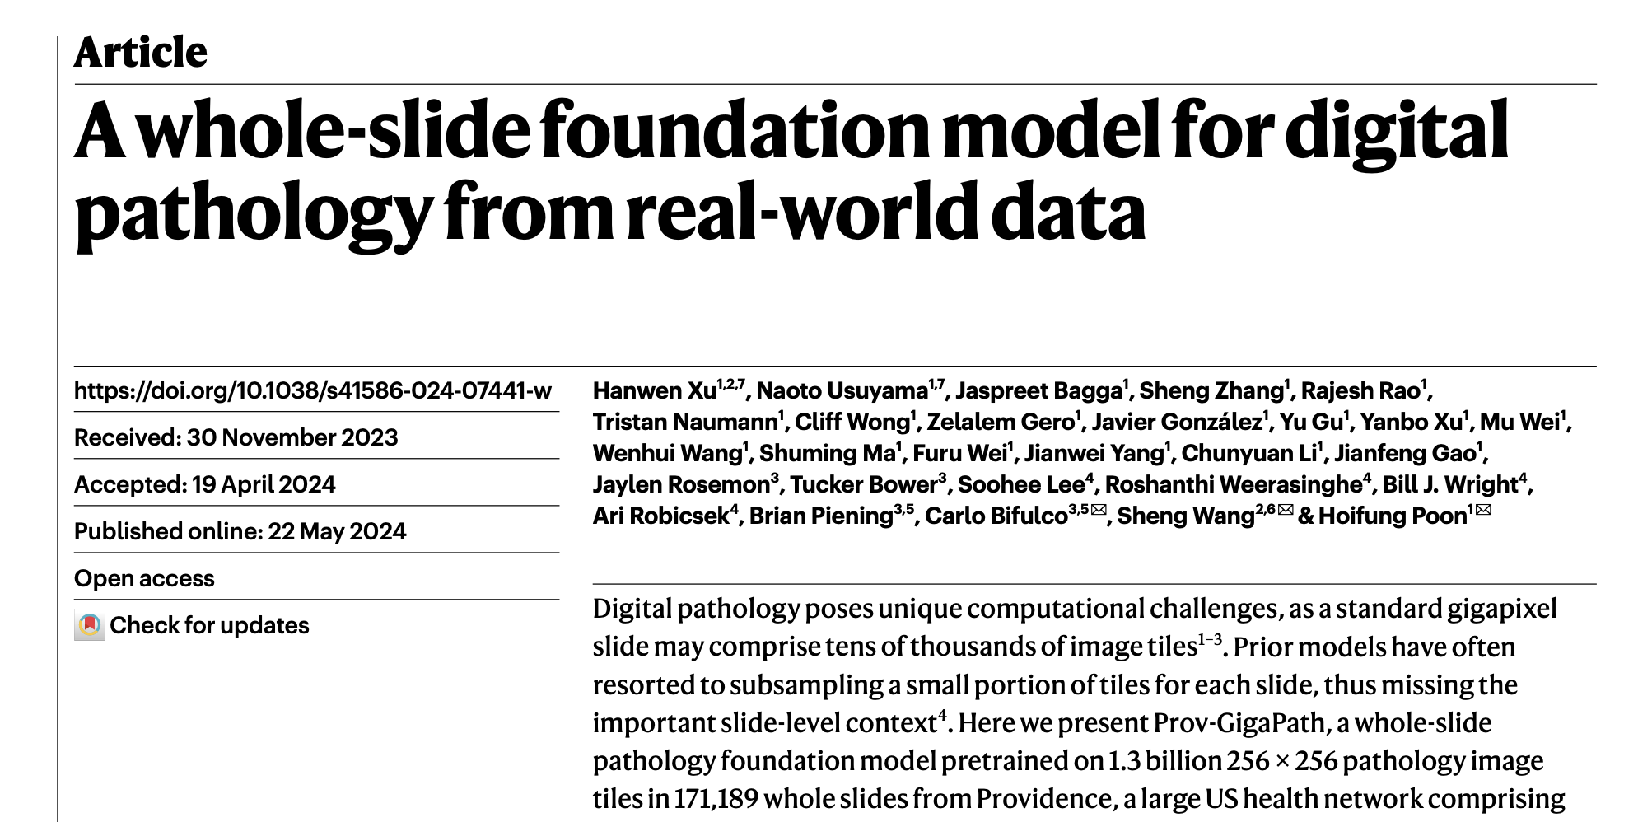

Slide 3
Three challenges addressed by Prov-GigaPath:
Publicly available pathology data are relatively scarce and of varying quality.
Prov-GigaPath is pre-trained on Prov-Path, which contains 1,384,860,229 256X256 image tiles from 171,189 slides, covering 31 major tissue types.
2. the resulting foundation models are typically not accessible to the public, thus limiting their broader applicability in clinical research and applications.
Prov-GigaPath is fully open-weight, including source code and pretrained model weights.
3. it is challenging to design a model architecture that can effectively capture both local patterns in individual tiles and global patterns across whole slides.
GigaPath, a novel vision transformer for pretraining large pathology foundation models on gigapixel pathology slides.

Slide 4
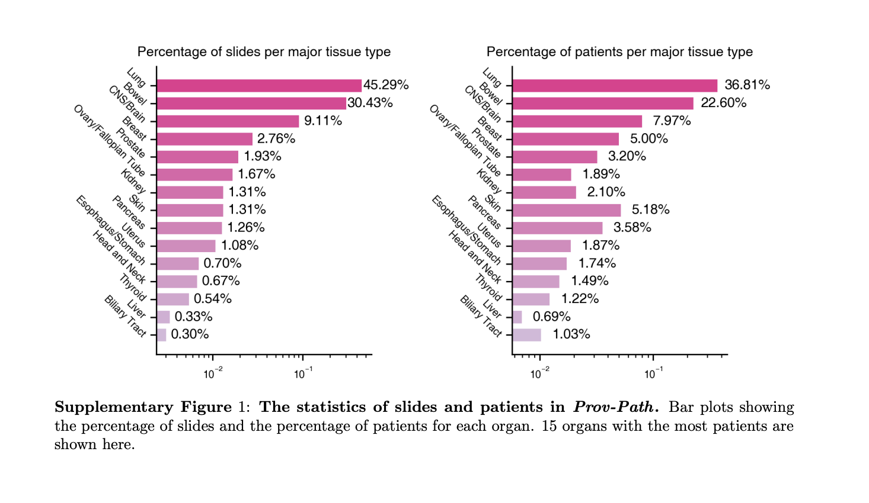
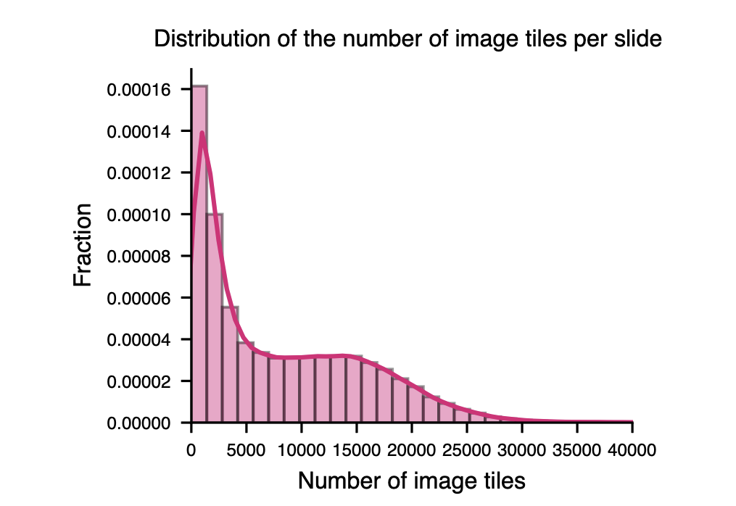
Prov-GigaPath is pre-trained on Prov-Path, which contains 1,384,860,229 image tiles from 171,189 slides, covering 31 major tissue types.
Tiles with an occupancy value of less than 0.1, determined by the Otsu algorithm, were discarded to focus on tissue-covered regions.

Slide 5
Three challenges addressed by Prov-GigaPath:
Publicly available pathology data are relatively scarce and of varying quality.
Prov-GigaPath is pre-trained on Prov-Path, which contains 1,384,860,229 image tiles from 171,189 slides, covering 31 major tissue types.
2. the resulting foundation models are typically not accessible to the public, thus limiting their broader applicability in clinical research and applications.
Prov-GigaPath is fully open-weight, including source code and pretrained model weights.
3. it is challenging to design a model architecture that can effectively capture both local patterns in individual tiles and global patterns across whole slides.
GigaPath, a novel vision transformer for pretraining large pathology foundation models on gigapixel pathology slides.

Slide 6
Overview
1. Tile Embedding: Use DINOv2 to pretrain a tile encoder that captures local features from individual image tiles in pathology slides. Convert all tiles into a sequence of tile-level embedding embeddings.
2. Global Feature Encoding: Use a slide encoder with LongNet to generate contextualized embeddings from the sequence, capturing global features across the entire slide.
3. Aggregation
4. Fine-Tuning
5. Evaluation
Notes:
Tile Embedding: Use DINOv2 to pretrain a tile encoder that captures local features from individual image tiles in pathology slides.
Sequence Formation: Convert all tiles into a sequence of embeddings.
Global Feature Encoding: Use a slide encoder with LongNet to generate contextualized embeddings from the sequence, capturing global features across the entire slide.
Aggregation: Apply a softmax attention layer to aggregate the slide-level embeddings for downstream clinical tasks.
Fine-Tuning: Fine-tune the pretrained model on specific tasks using relevant data.
Evaluation: Test and evaluate the model on various clinical applications.

Slide 7
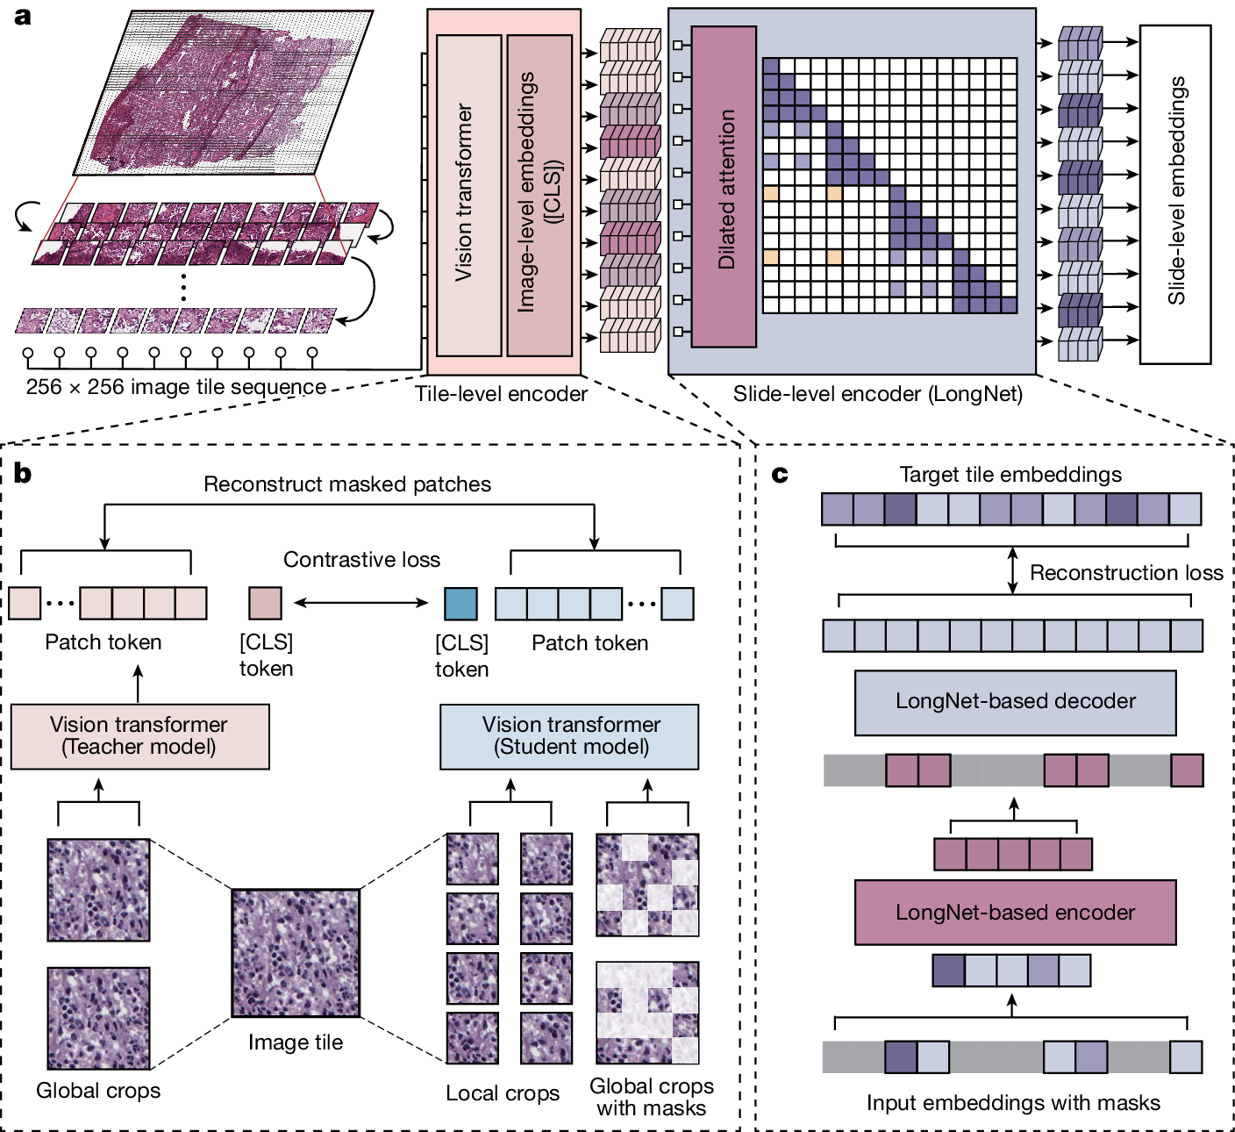

Slide 16
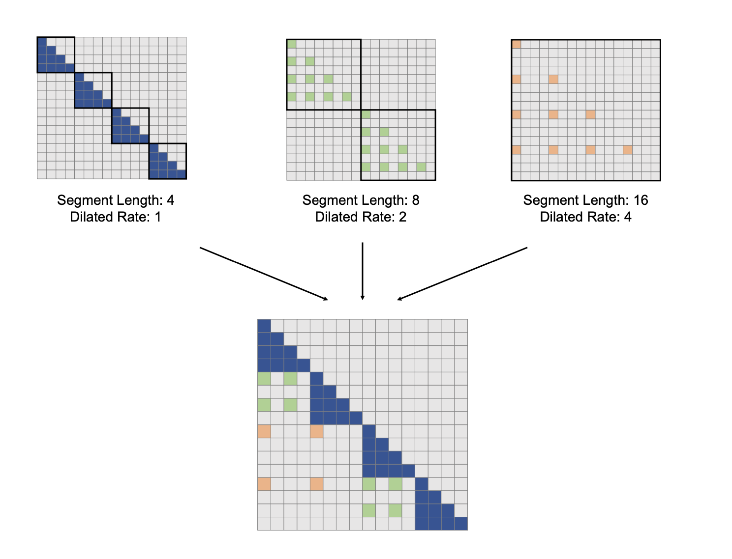
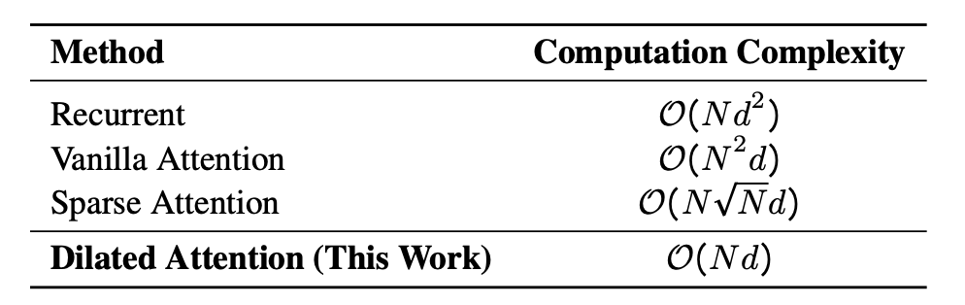
Slide-level encoder
LONGNET: Scaling Transformers to 1,000,000,000 Tokens: https://arxiv.org/pdf/2307.02486

Slide 17
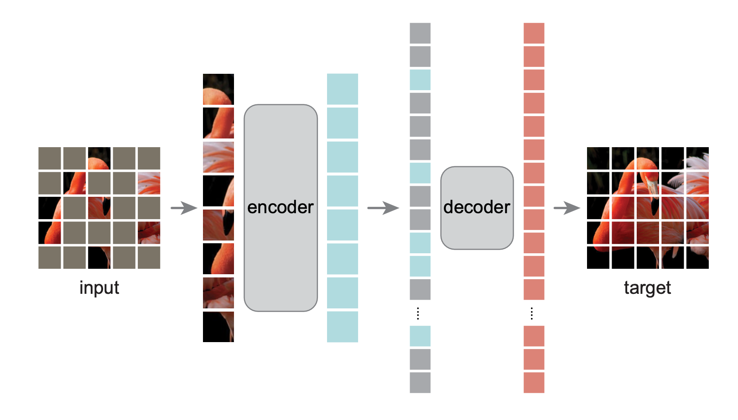
Slide-level encoder
Masked Autoencoders Are Scalable Vision Learners: https://arxiv.org/pdf/2111.06377

Slide 19
Fine-Tuning: Fine-tune the pretrained model on specific tasks (mutation prediction, cancer subtyping) using relevant data.
Freeze Tile Encoder: The pretrained tile encoder is frozen to retain the learned local features without updating them during fine-tuning.
Fine-Tune LongNet Slide Encoder: The LongNet slide-level encoder is fine-tuned to adapt to the specific downstream tasks, allowing it to capture global patterns across the slide.
Generate Tile Embeddings: LongNet produces contextualized embeddings for each tile in the slide.
Aggregate with ABMIL: A shallow ABMIL layer aggregates these embeddings into a single slide-level embedding.
Downstream Prediction: The aggregated slide embedding is used in additional classifiers for specific predictions or tasks, such as image classification task for mutation prediction.
Notes:
Tile Embedding: Use DINOv2 to pretrain a tile encoder that captures local features from individual image tiles in pathology slides.
Sequence Formation: Convert all tiles into a sequence of embeddings.
Global Feature Encoding: Use a slide encoder with LongNet to generate contextualized embeddings from the sequence, capturing global features across the entire slide.
Aggregation: Apply a softmax attention layer to aggregate the slide-level embeddings for downstream clinical tasks.
Fine-Tuning: Fine-tune the pretrained model on specific tasks using relevant data.
Evaluation: Test and evaluate the model on various clinical applications.

Slide 20
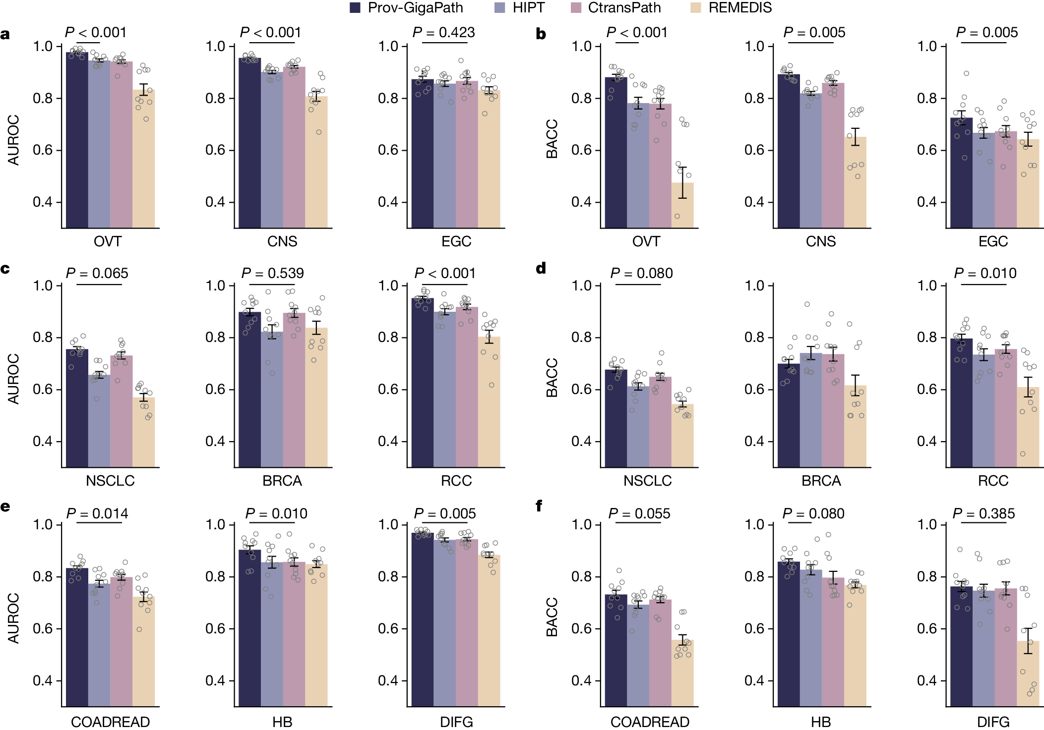
Prov-GigaPath improves cancer subtyping

Slide 21
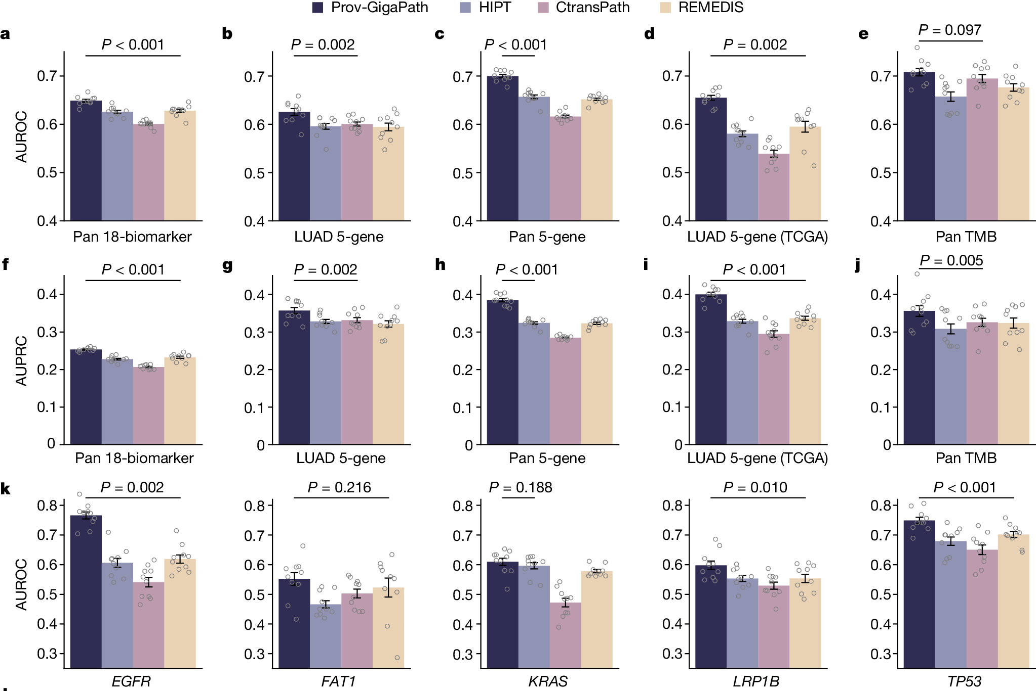
Prov-GigaPath improves mutation prediction
TMB: tumour mutation burden (TMB), a predictive biomarker in solid tumours that is particularly relevant for immunotherapy

